Slide 1
AMAZON RAINFOREST AND WILDFIRE
BY ADITYA SINGH 2K19/EP/005

Slide 2
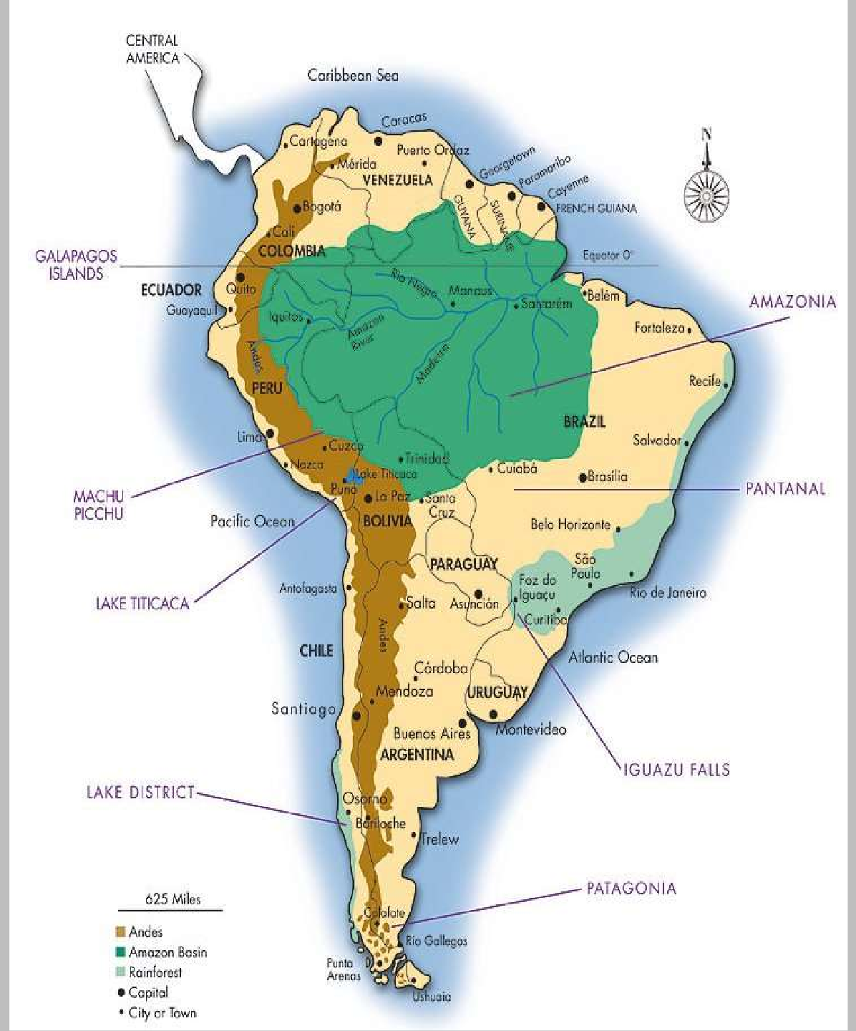






OVERVIEW
The Amazon rainforest is the largest rainforest in the world.
It represents over half of the planet's rainforests.
Comprises the largest and most biodiverse tract of tropical rainforest in the world.
Area by Countries
Colombia
10%
Others
17%
Brazil
Peru 13%
60%

Slide 3
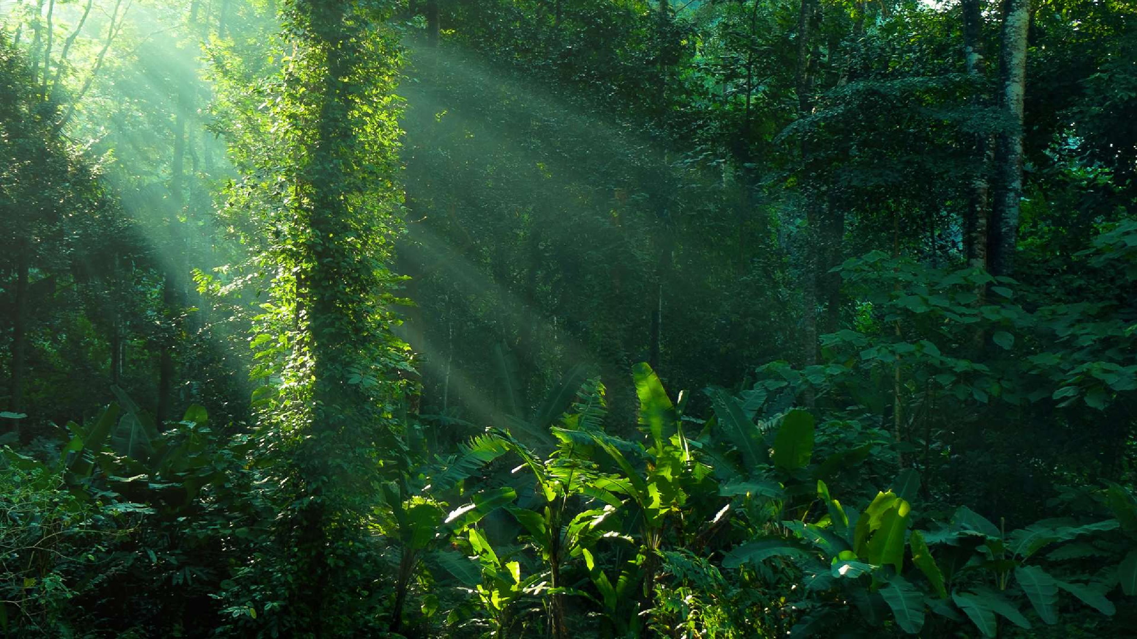

LUNGS OF EARTH
With an estimated 390 billion individual trees divided into 16,000
species.
One in ten known species in the world lives in the Amazon rainforest.

Slide 4
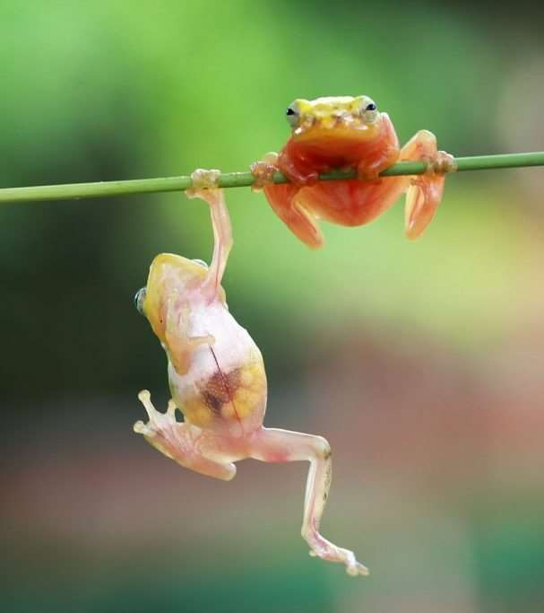
BIODIVERSITY
The region is home to about 2.5 million insect species.
40,000 plant species, 2,200
fishes, 1,294 birds, 427 mammals, 428 amphibians, and 378 reptiles have been scientifically classified in the region.
One in five of all bird species are found in the Amazon rainforest, and one in five of the fish species live in Amazonian rivers and streams.

Slide 5
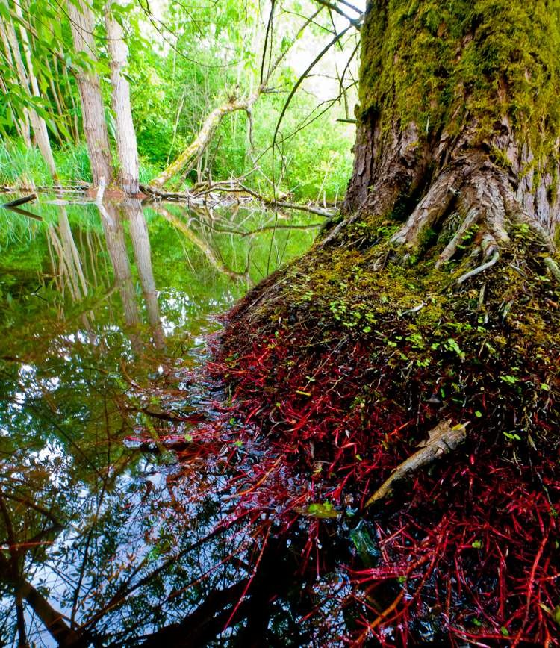
MEDICINAL PLANTS
Scientists believe that less than half of 1% of flowering plant species have been studied in detail for their medicinal potential.
So far, this includes plants that can be used for AIDS, cancer, diabetes, arthritis, multiple sclerosis and
Alzheimer’s drugs and cures, and hopefully many more in the future.

Slide 6
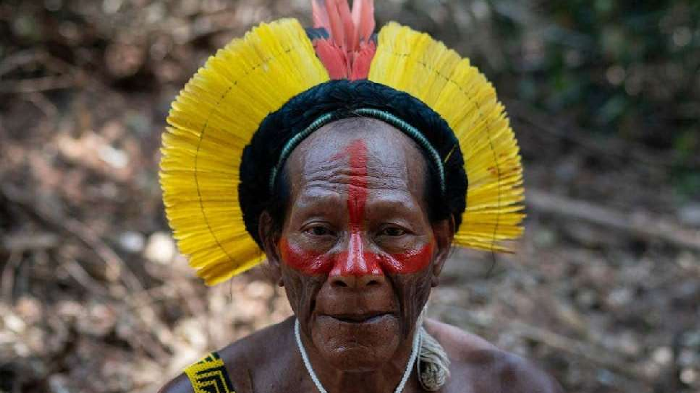

PEOPLE & COMMUNITIES
More than 30 million people, including 350 indigenous and ethnic groups, live in the Amazon and depend on nature for agriculture, clothing and traditional medicines.
Most live in large urban centres, but all residents rely on the Amazon’s natural bounty for food, shelter and livelihoods.

Slide 7
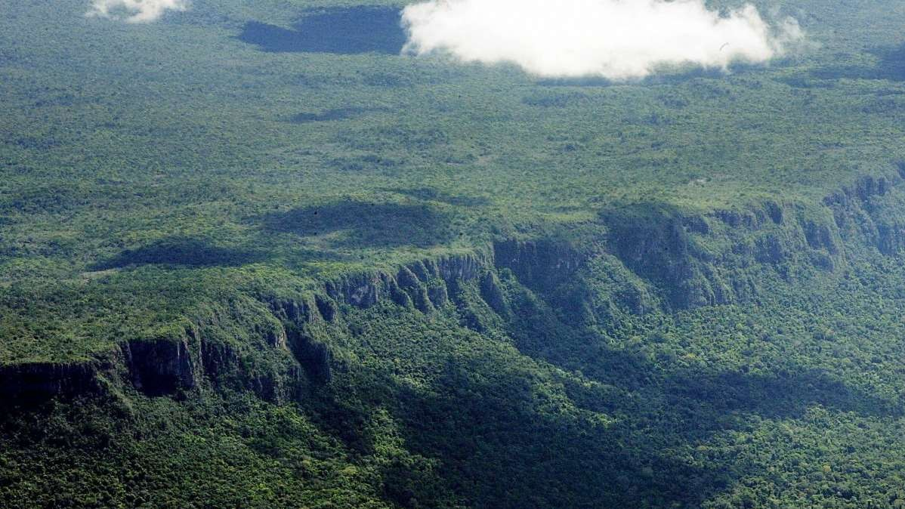
THREATS

Slide 8
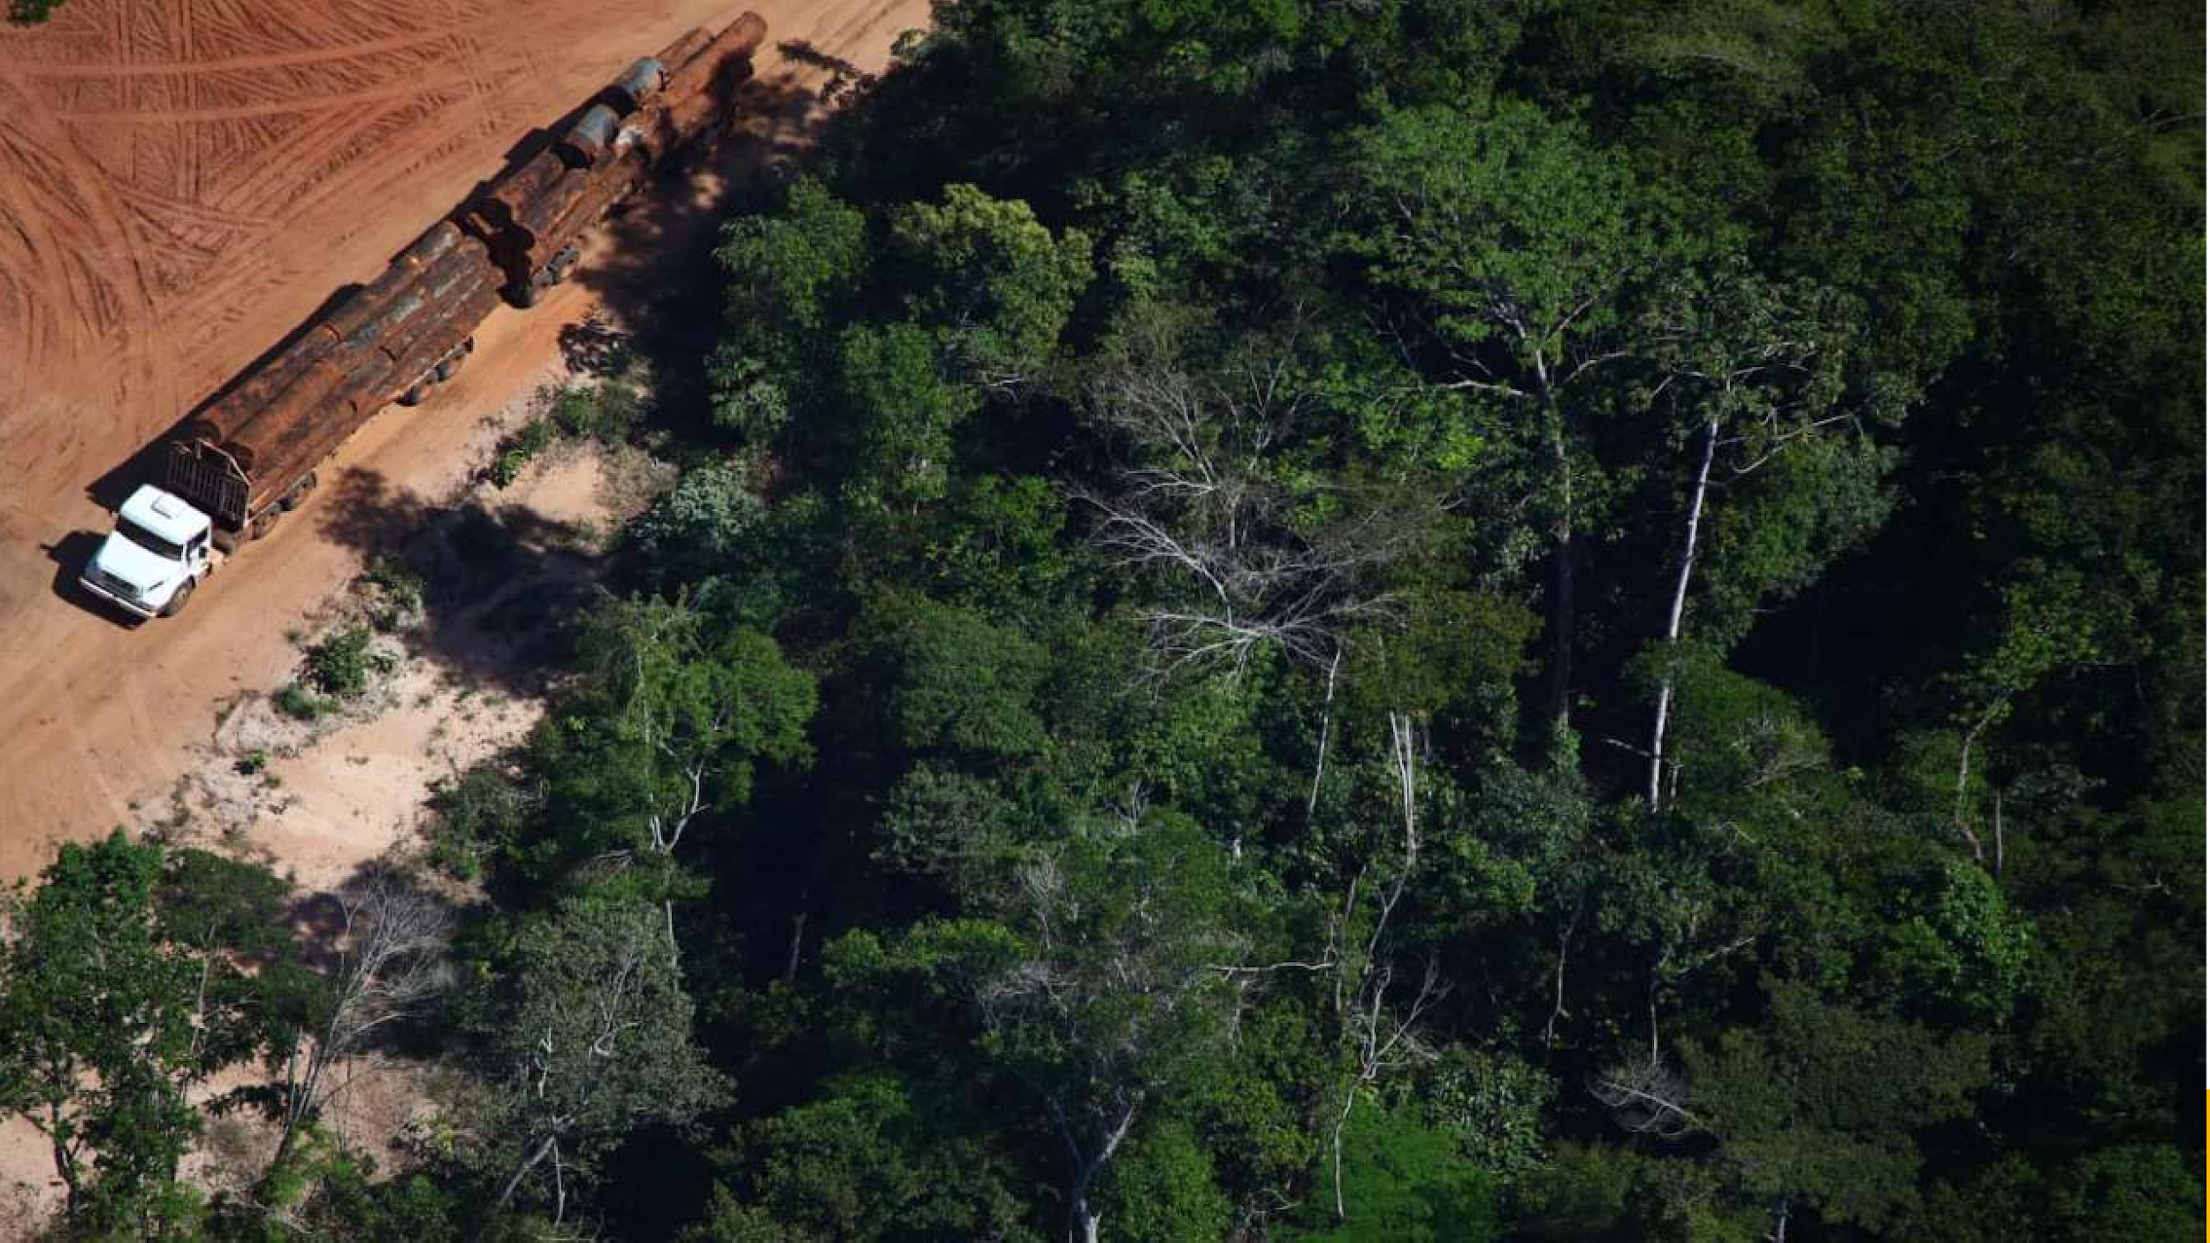

DEFORESTATION
Deforestation of the Amazon rainforest can be attributed to many different factors at local, national, and international levels.
The main sources of deforestation in the Amazon are human settlement and development of the land.

Slide 9
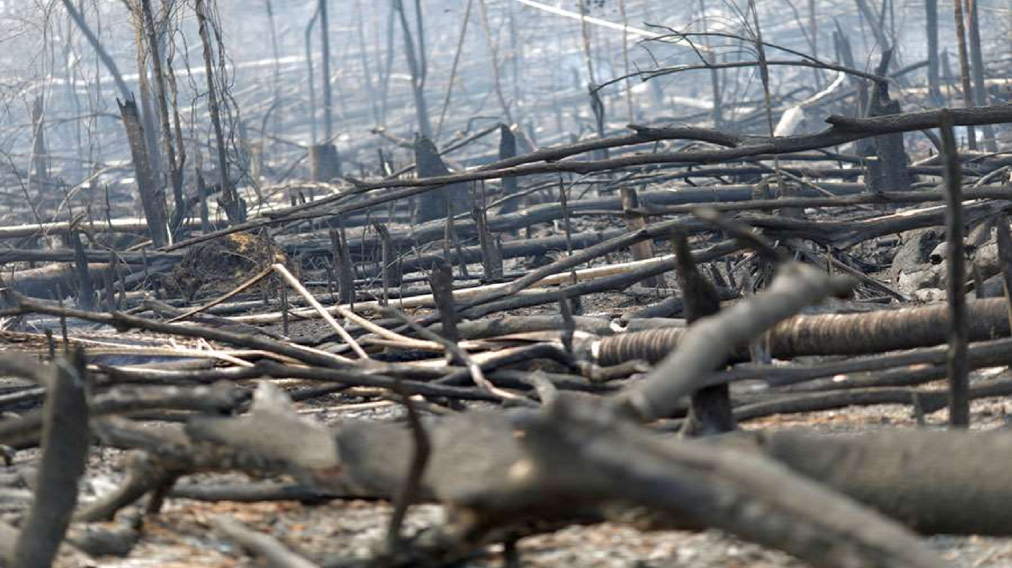

Causes of Deforestation
The rainforest is seen as a resource for cattle pasture, valuable hardwoods, housing space, farming space (especially for soybeans), road works (such as highways and smaller roads), medicines and human gain. Trees are usually cut down illegally.

Slide 10


Figures:
Figures for specific causes of deforestation in the Amazon are spotty at best. Below are some rough estimated ranges, based on published data, informal surveys, and other sources.
Estimated
3%
2% 5%
30%
60%
Cattle ranches Small-scale, subsistence agriculture
Large-scale, commercial agriculture Logging, legal and illegal
Fires/mining/urbanization/road construction/dams

Slide 11
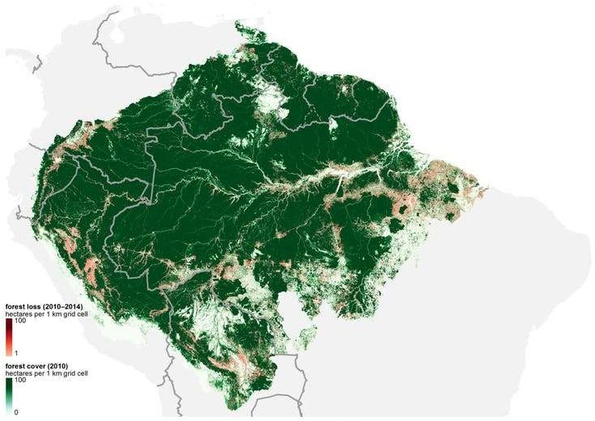
Forest Cover
& Loss

Slide 12
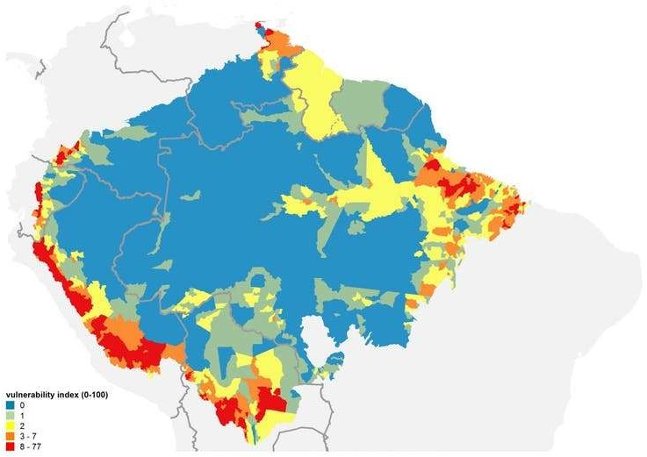
Most Vulnerable Climate Change Areas

Slide 13



Forest Loss Table (1970-2018)
Estimated remaining forest cover
4200000
4000000
3800000
3600000
3400000
3200000
3000000

Slide 14
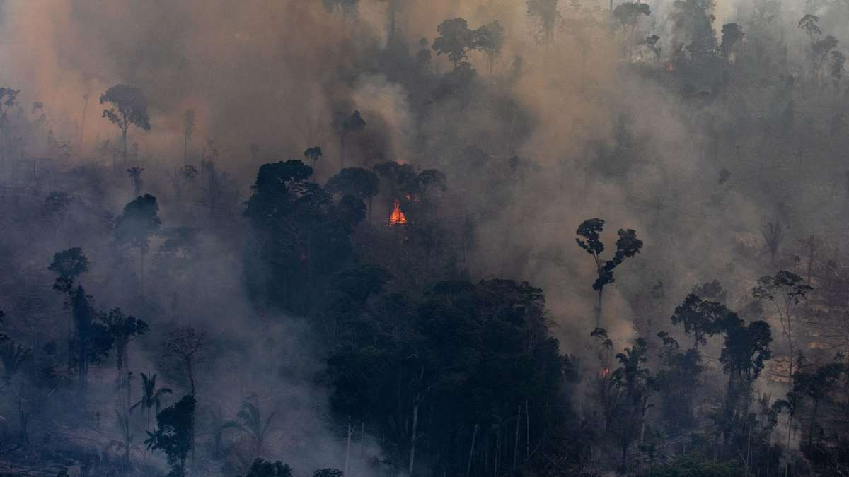
2019 Amazon
Rainforest Wildfires

Slide 15
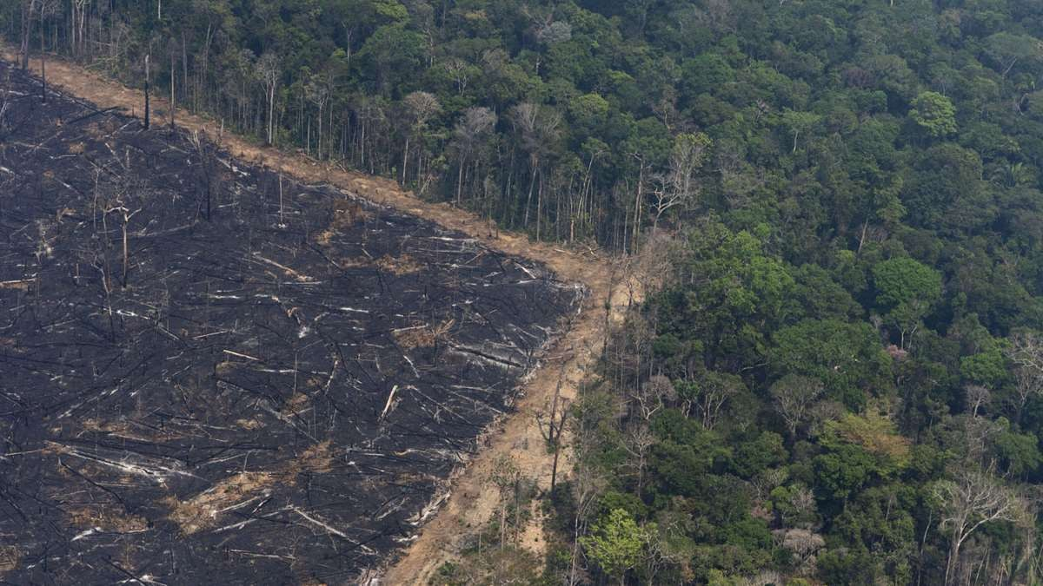
How did the Amazon rainforest fires start?
INPE research Alberto Setzer told Reuters: “The dry season creates the favourable conditions for the use and spread of fire, but starting a fire is the work of humans, either deliberately or by accident.“

Slide 16
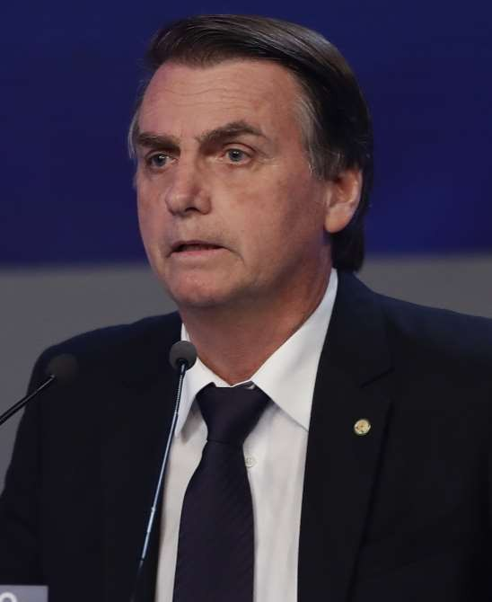
Jair Messias Bolsonaro is a Brazilian politician and retired military officer, serving as the 38th President of Brazil since 1 January 2019.
Conservationists have blamed the country's president, Jair Bolsonaro, for the current Amazon rainforest fires, saying he has encouraged loggers and farmers to clear the land.

Slide 17
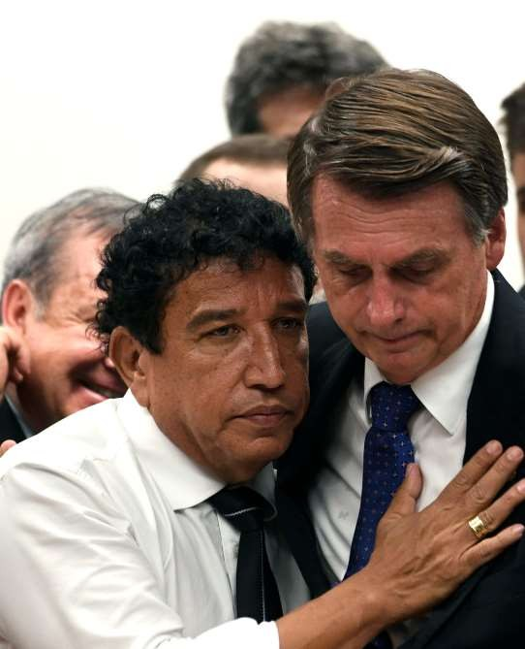
His party claim that there is nothing exceptional happening in the Amazon, and that the rising international pressure is a result of the same supposed lies about global warming.
These are baseless ravings of a hubristic leader who continues to put his personal ideology ahead of facts and what's best for those he is supposed to serve.
It's that same hubris that led him to reject the $22 million in aid the G7 nations recently offered to help fight the fires.

Slide 18
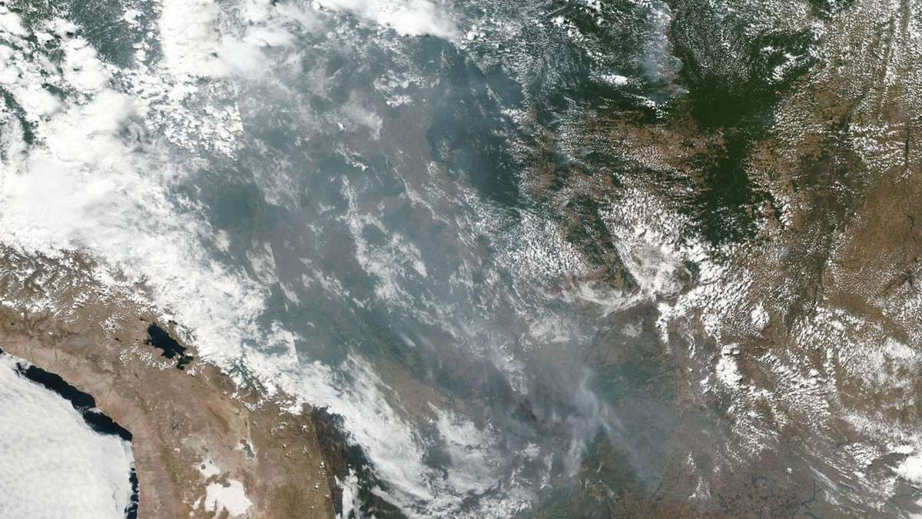
The National Institute for Space Research (INPE) has recorded more than 74,000 fires so far that year – an 84 percent increase on the same period in 2018. It’s the highest number since records began in 2013.

Slide 19
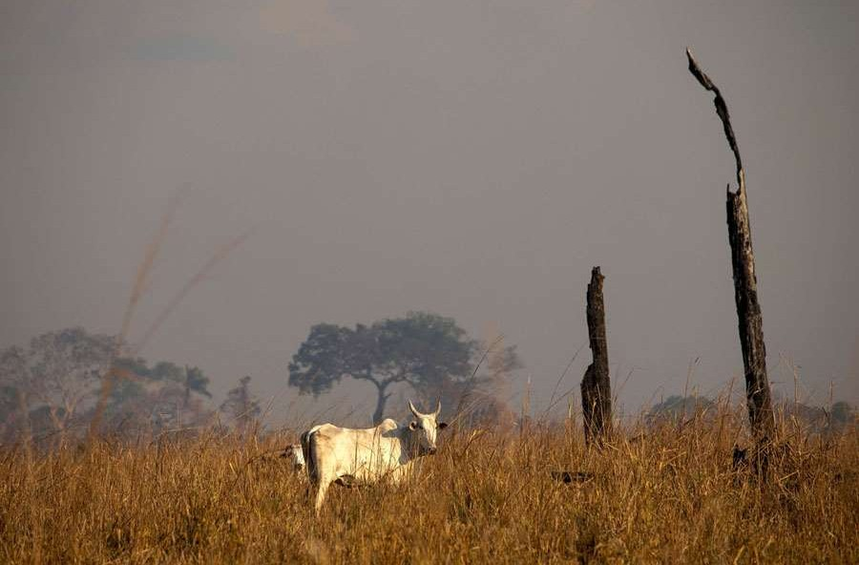
Farming
In Brazil, cattle farmers start fires deliberately to clear forest to make way for ranching, and
it’s not always
legal.

Slide 20
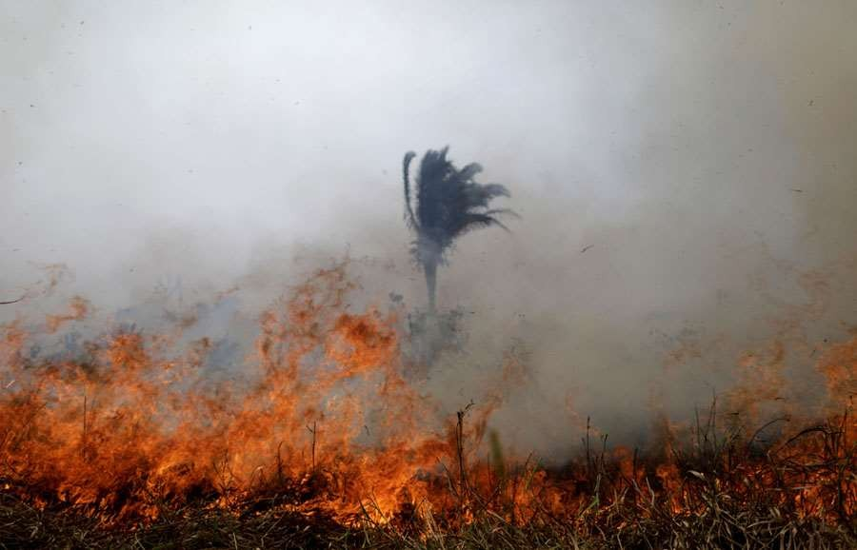
High Alert
Brazil has declared a state of emergency in the region. The fires are destroying the homes of indigenous tribes and threatening millions of animal species.
One tribal chief described the halting response of Brazil's president, Jair Bolsonaro, regarding the fires, along with his support for deforestation, as a form of genocide.

Slide 21
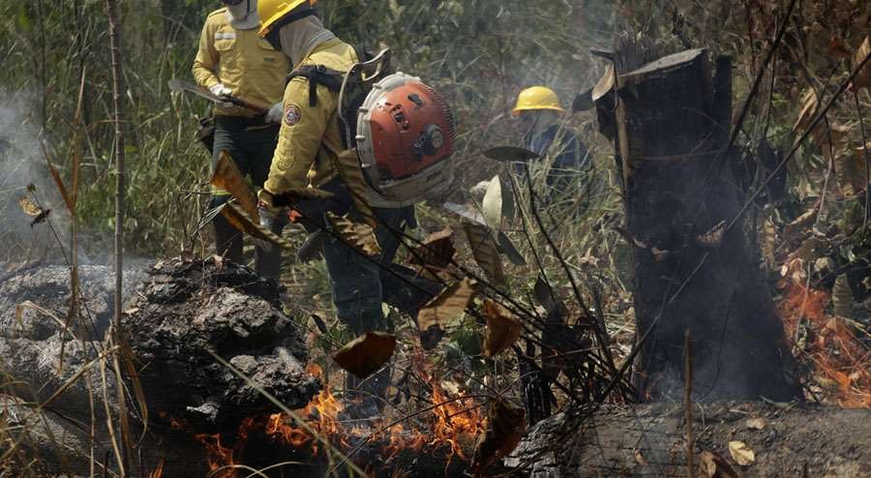
In late August, the G7 Summit -- an annual meeting of the leaders of Canada, France, Germany, Italy, Japan, the UK and the US -- agreed on the aid package, according to The Hill on Aug, 26. Brazil's president originally had accepted the aid and tweeted that Brazil is committed to environmental protection.

Slide 22
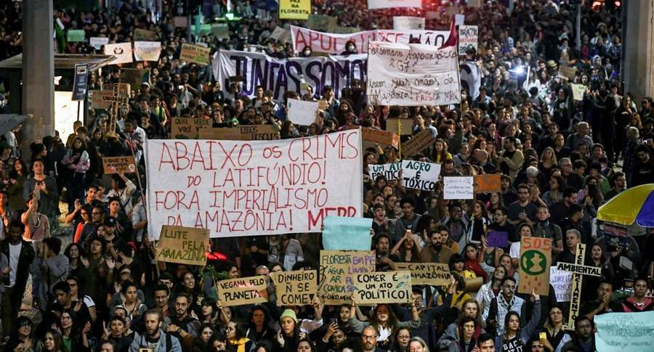
Public Response
#ActForTheAmazon began trending on Twitter. In Zurich, activists from the Ecological Movement and Brazilians assembled outside of the Brazilian Consulate on Aug 23.
In Dublin, the Extinction Rebellion Collective occupied the Brazilian Embassy. Twitter users captured images of a protest in Barcelona as well. Demonstrations have also taken place in Paris, London, Madrid and Copenhagen, Denmark.

Slide 23
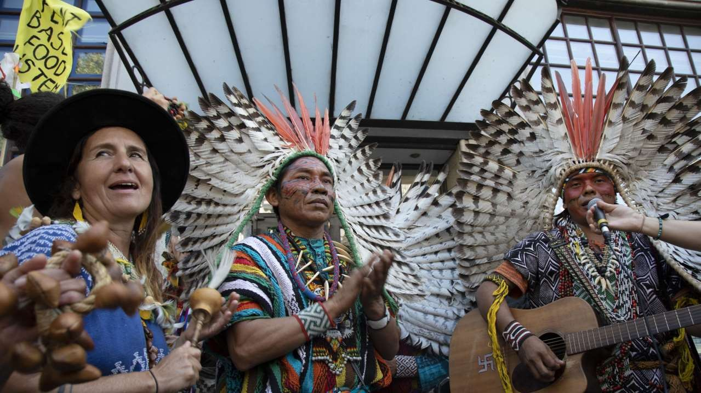
Members of an indigenous tribe from the Amazon sing during a protest organized by Extinction Rebellion at the Brazilian Embassy in London.

Slide 24
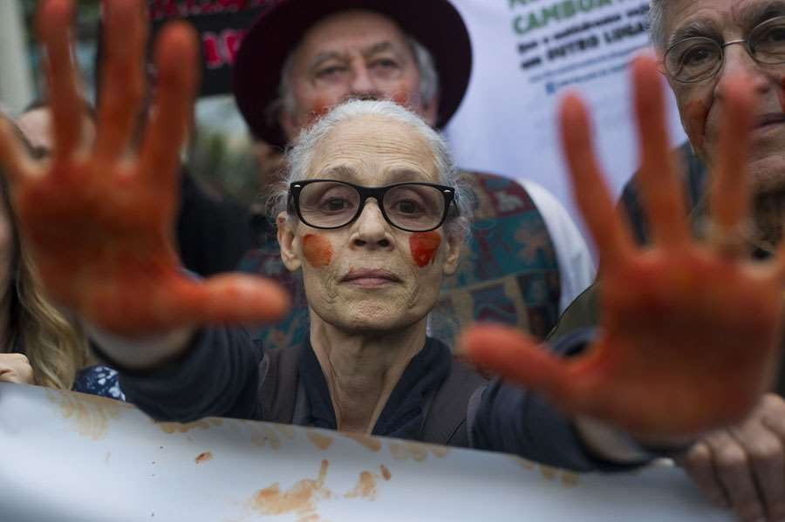
The Brazilian actress Sonia Braga shows her hands painted red, representing blood, during a protest in defense of the Amazon while wildfires burn in that region, in Rio de Janeiro, on August 25, 2019

Slide 25
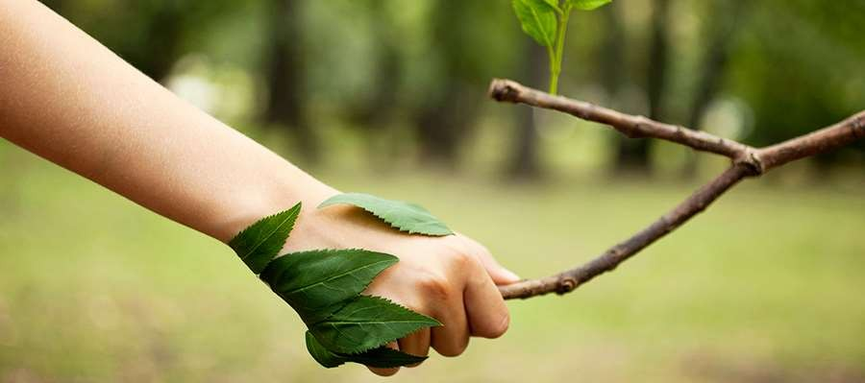
What Can We Do to Help The Amazon Rainforest?
And
Become Eco-Friendly

Slide 26
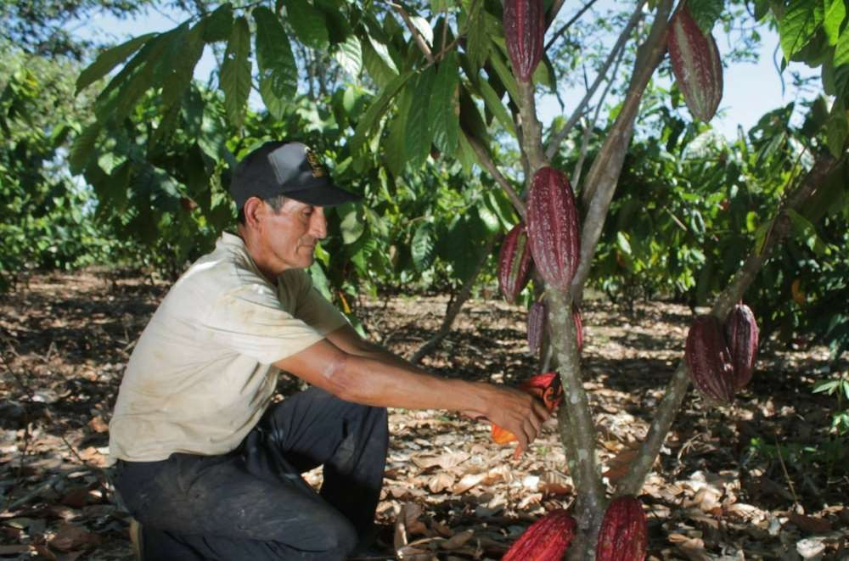
Help Buy Land In The Rainforest By Donating To The Rainforest Trust
The Rainforest Trust purchases sections of rainforests all over the world and then partners with conservationists on projects to preserve specific habitats, communities, and species.

Slide 27
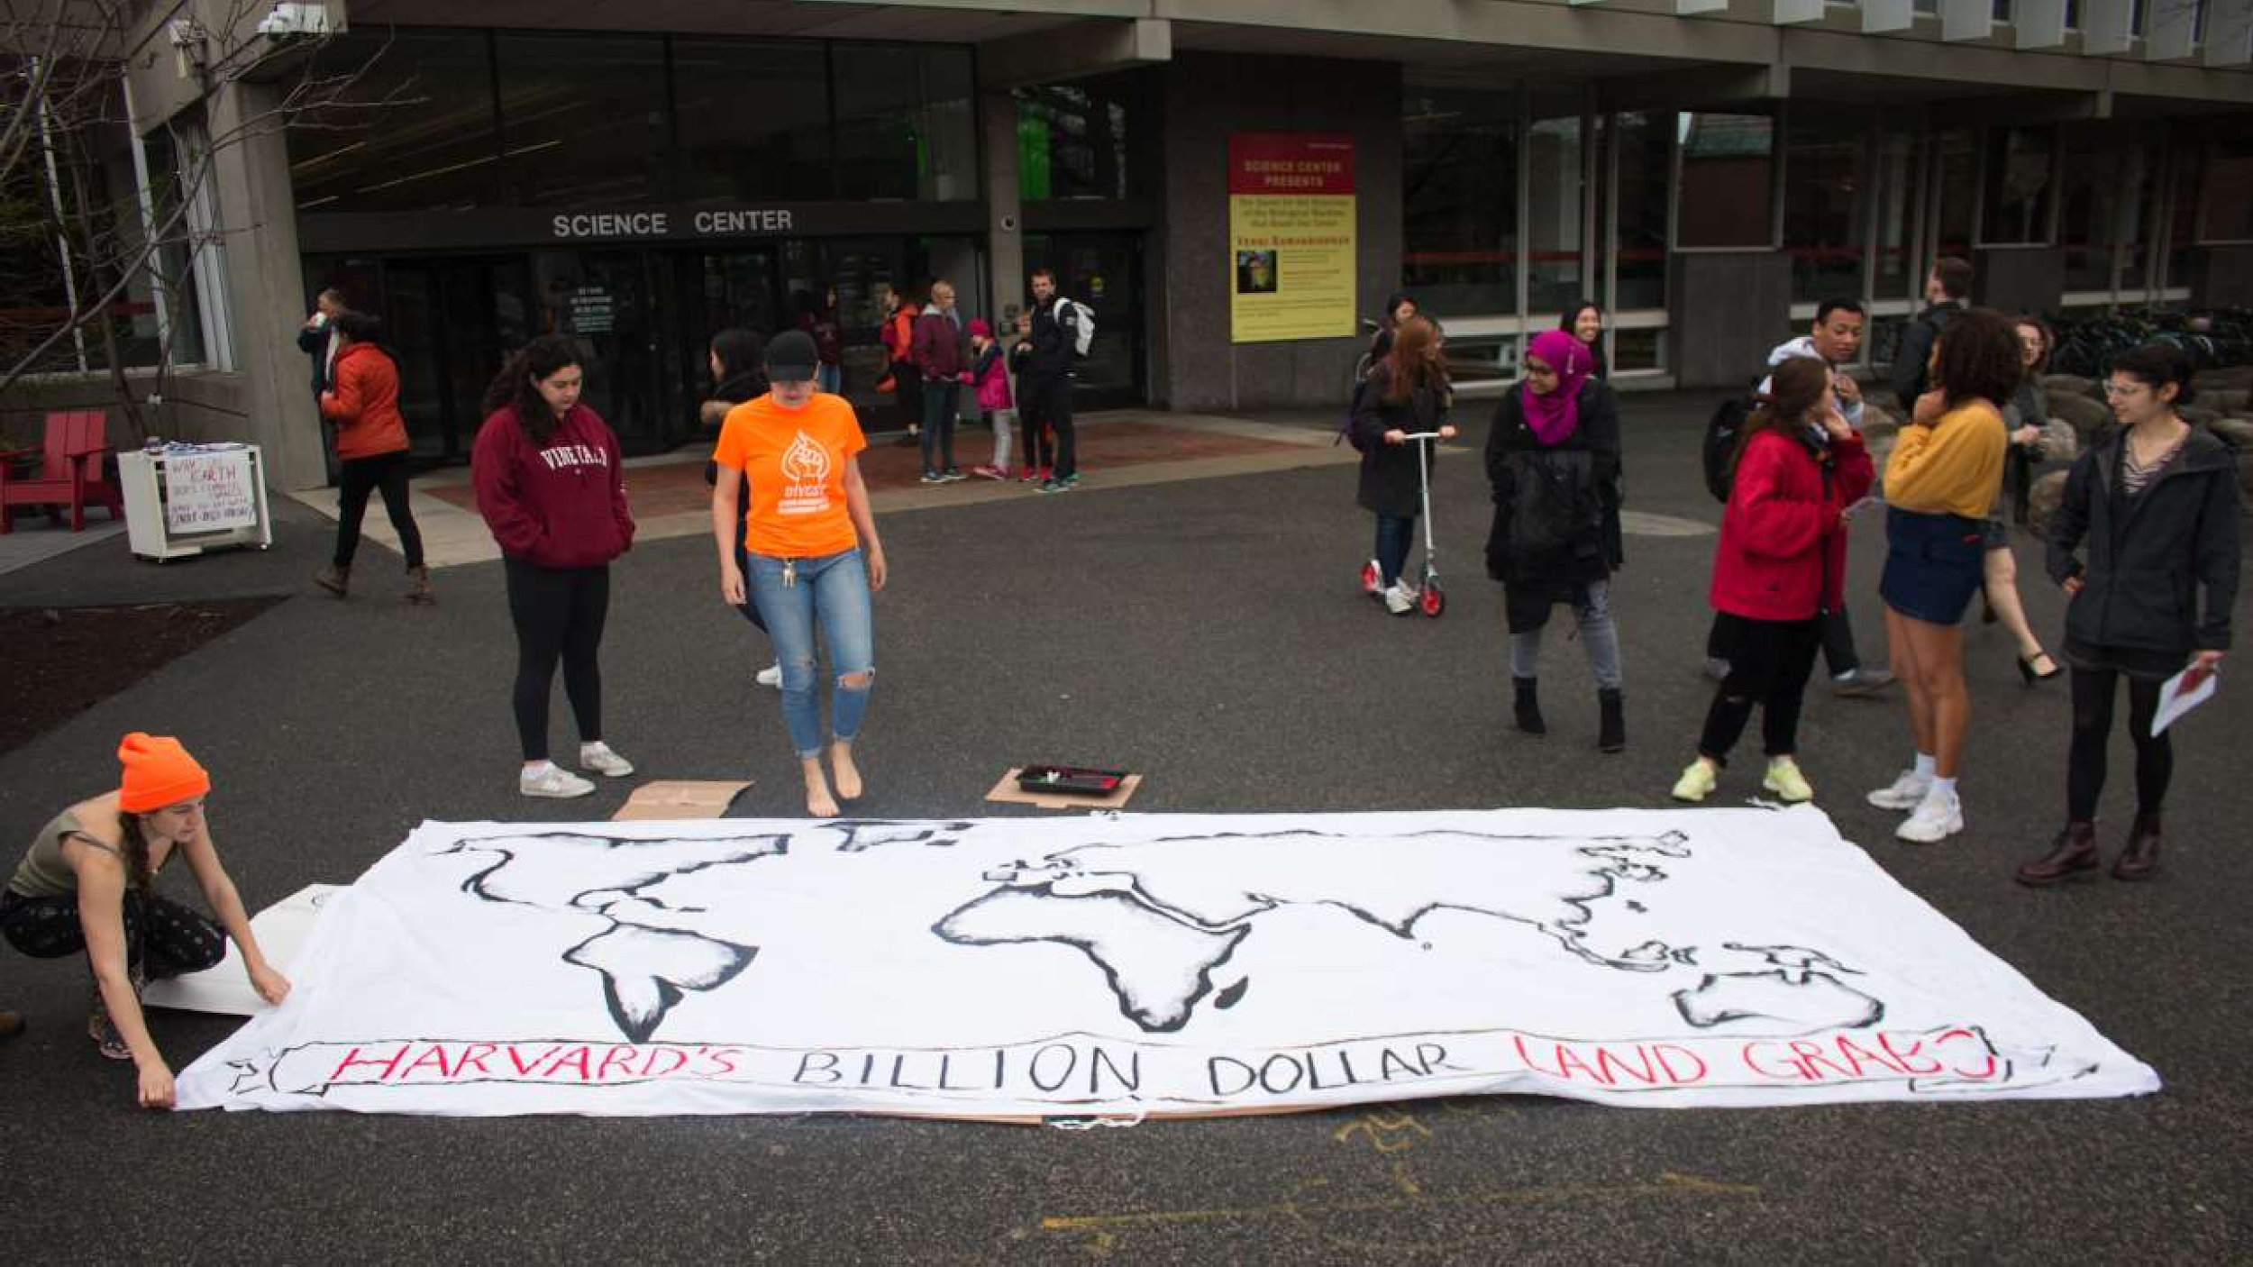
Support Rainforest Action Network

Slide 28
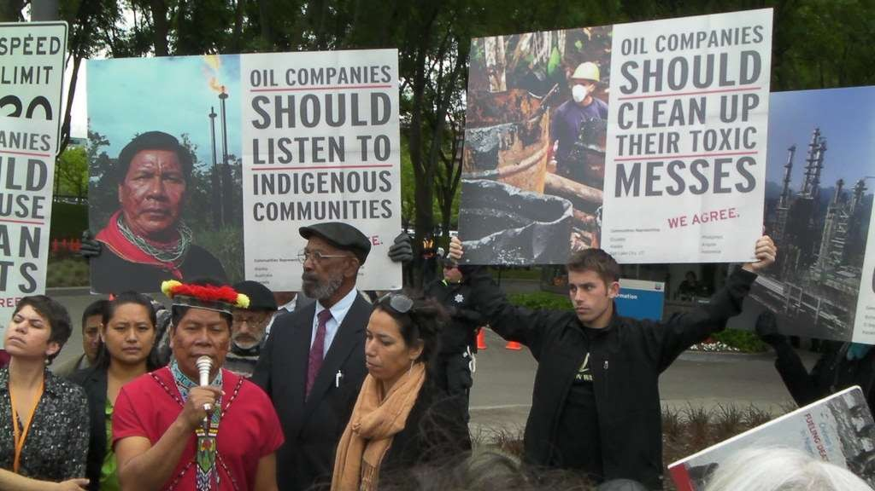
The simplest and most reliable way to mitigation damage from oil operations would be to prohibit oil extraction in the tropical rainforest. But that is unlikely given the number of tropical countries that produce oil and the wealth of oil deposits located in forest areas.

Slide 29
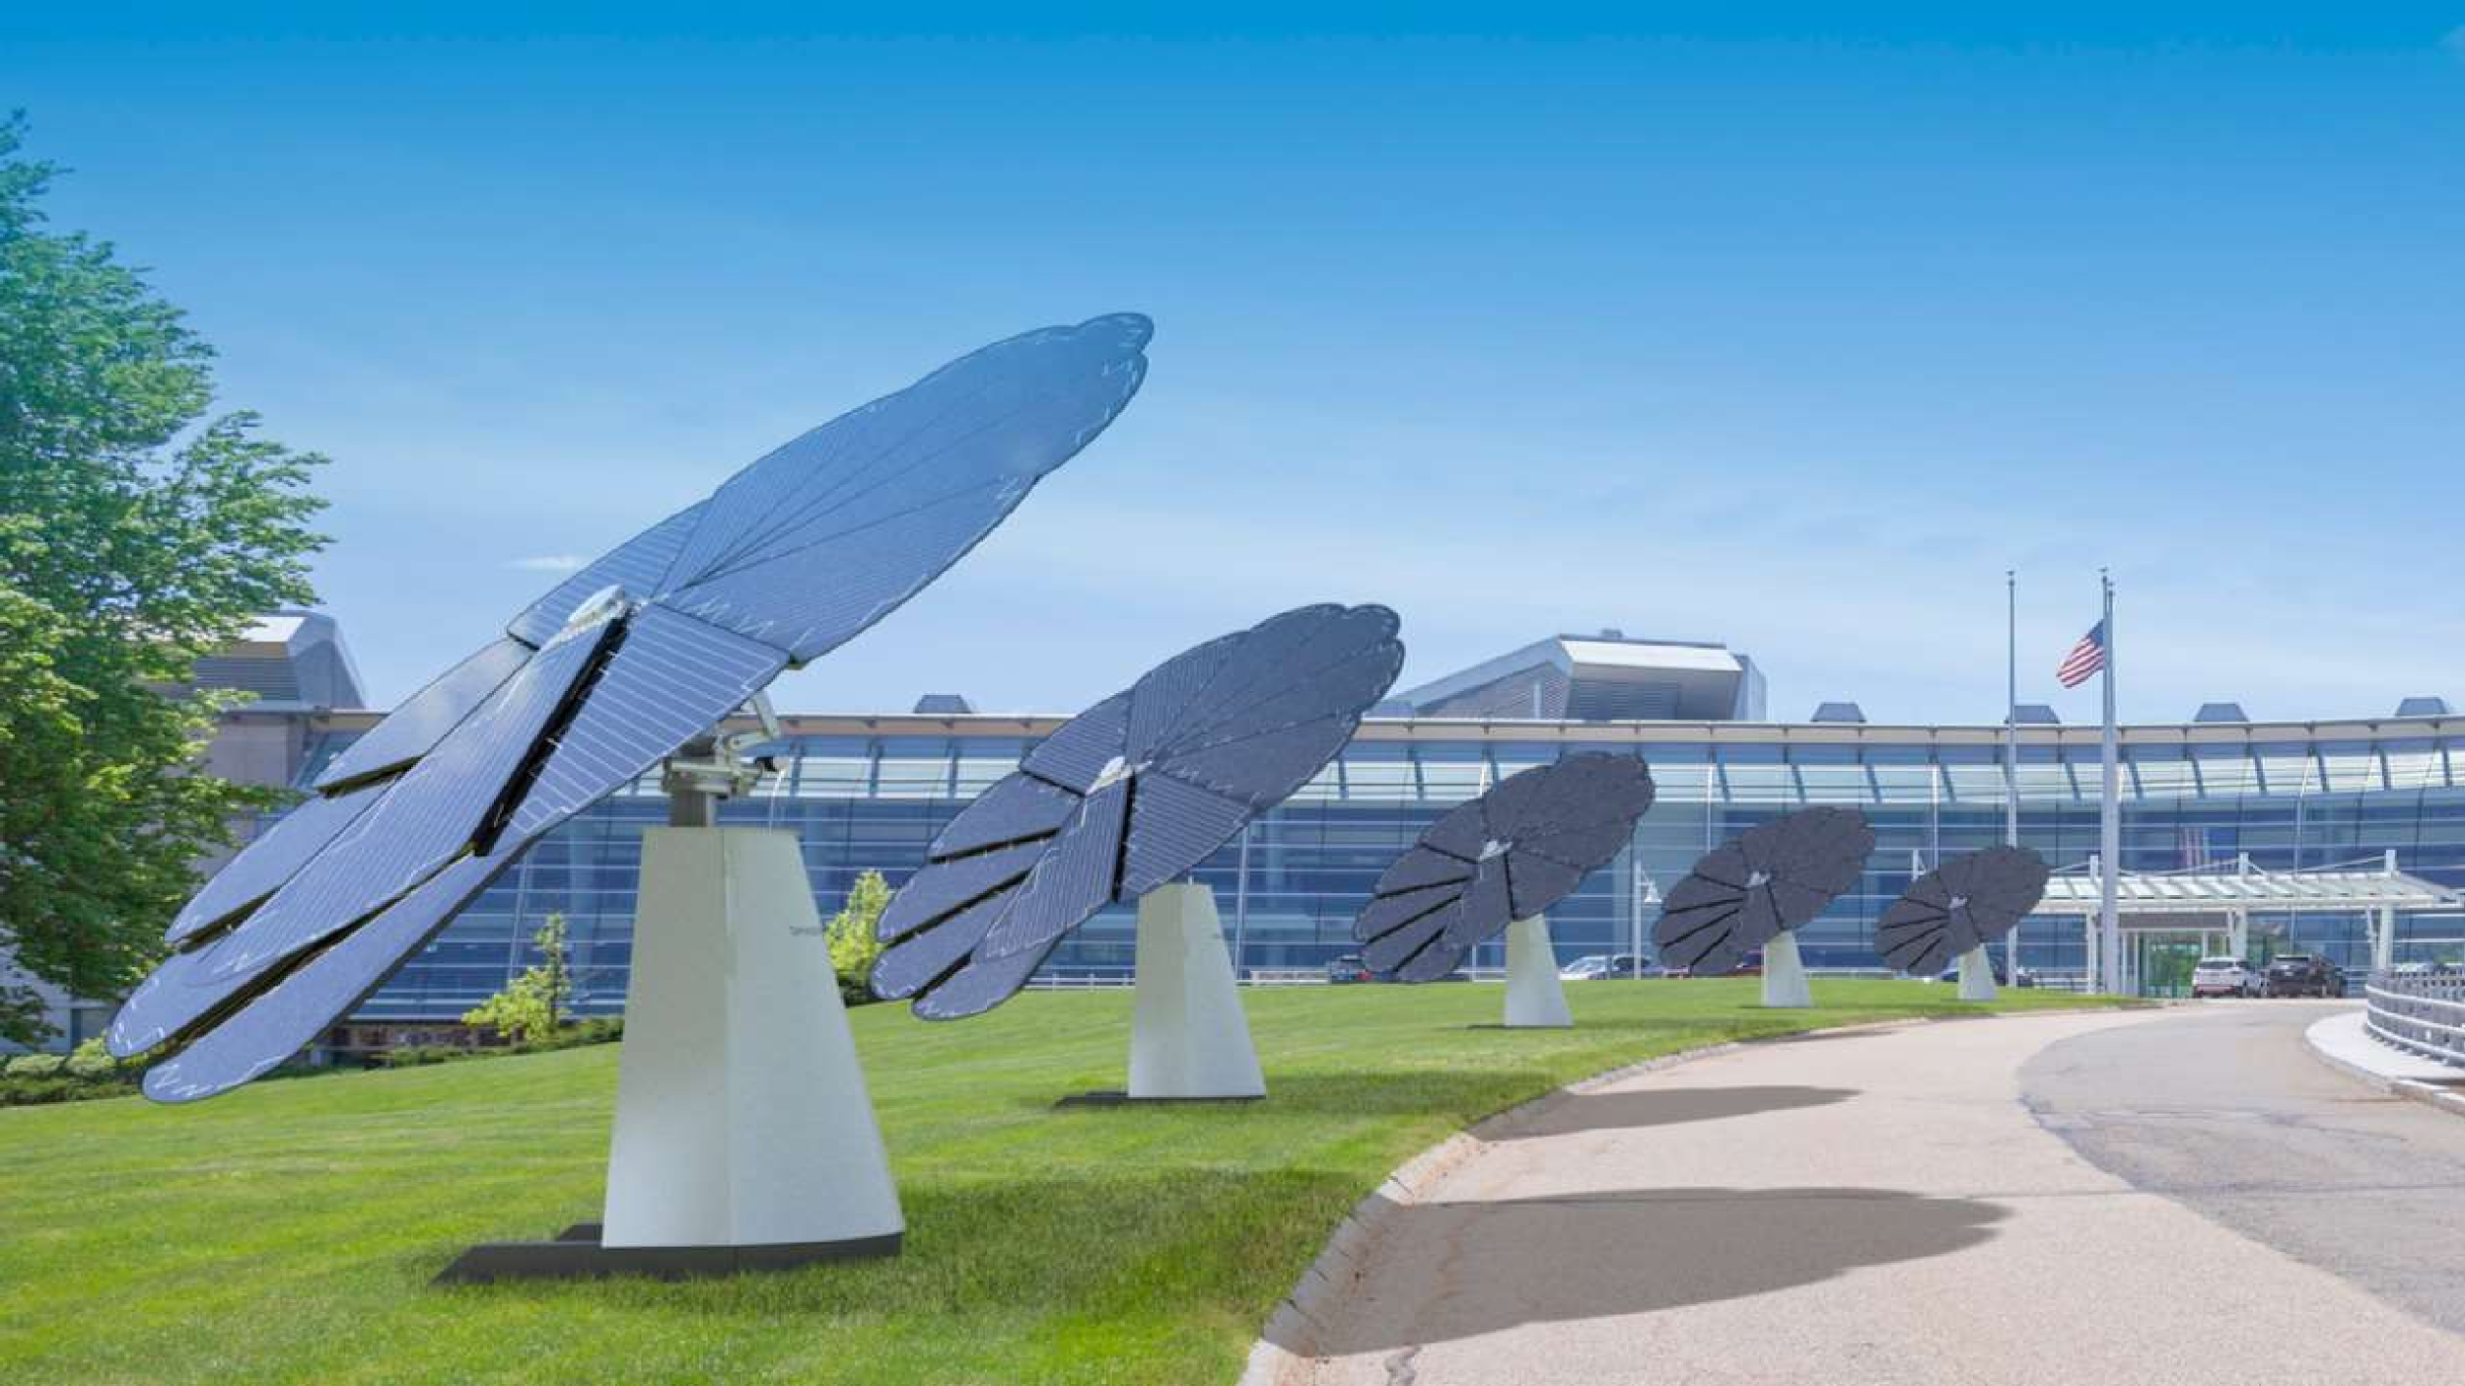

Sustainable Energy
Sustainable energy includes all renewable energy sources, such as
solar energies, hydroelectricity, biomass, geothermal, wind, wave and tidal.

Slide 30
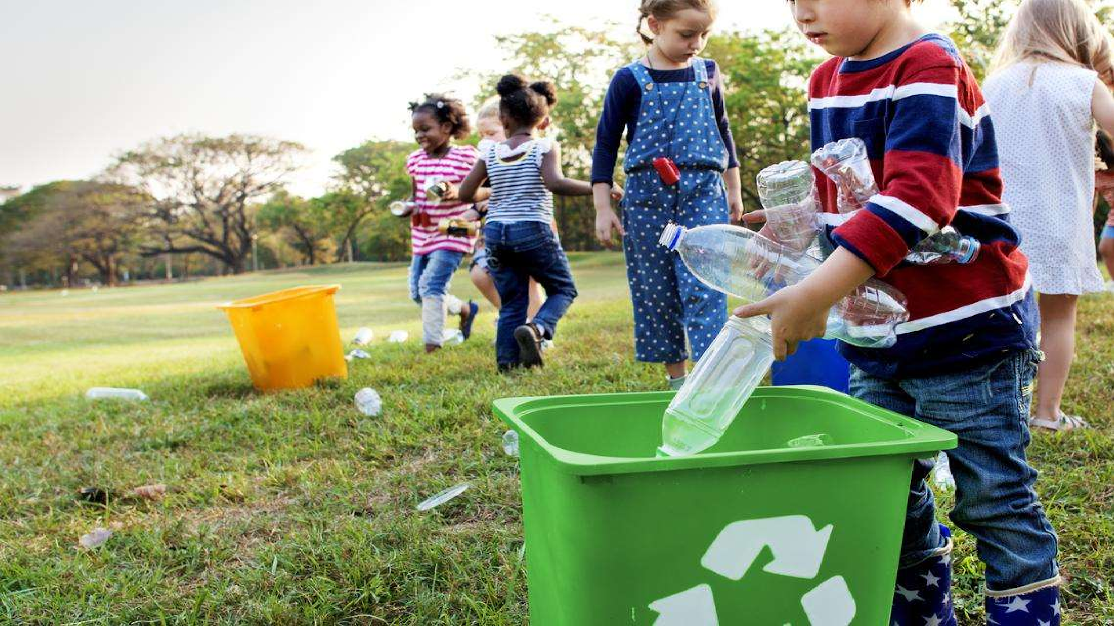

Plastic And Wood Recycling
Process of recovering different types of plastic material in order to reprocess them into varied other products, unlike their original form.
Waste wood is a precious resource that is available in large volumes and may be used either for material recycling or energy production, depending on the quality grade.

Slide 31


Paper-Saving Technologies
Although going completely paperless is usually out of reach for most businesses, you can nevertheless reduce your paper usage drastically.
Reducing your paper usage lowers costs, and the resulting digital workflow gains often make you more efficient.

Slide 32

Buy Eco-friendly products that help protect
against deforestation.

Slide 33
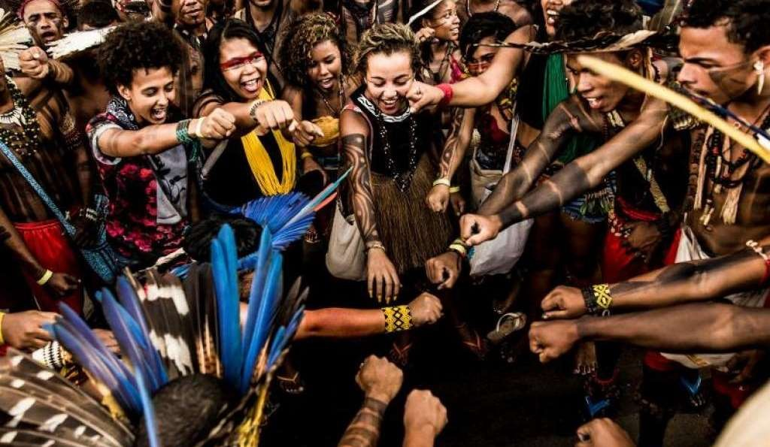
Signing the greenpeace petition to protect the rainforest.
And
Consider getting involved with or supporting climate activism.

Slide 34
THANK YOU

